Slide 1
Starbucks Locations vs. Household Income (U.S.)
Star Buck$
PRESENTED BY:
SYDNEY CAVALLARO, MORGAINE BOWERS, TRUMANE LEE, KELSEY VERMEER & ANA LINDA PENNY
Date: April 17, 2021

Slide 2









THE
TEAM
MORGAINE
KELSEY
SYDNEY
TRUMANE
ANA LINDA

Slide 3
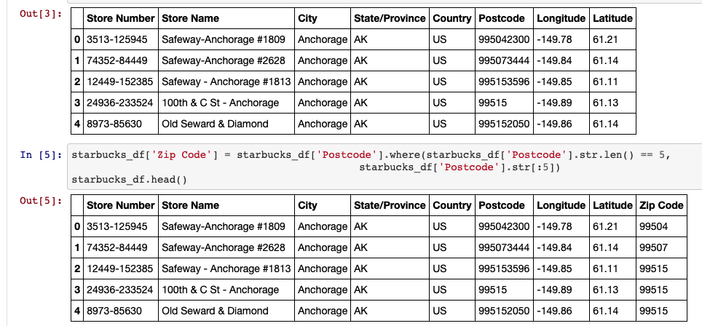
Cleaning the Datasets
Starbucks Locations DS
(Includes record of every Starbucks or Subsidiary Store location in operation as of February 2017)
Filtered out the international data
Focused on cleaning data for State, Postal Code, City, Ownership Type, Store Number

Slide 4
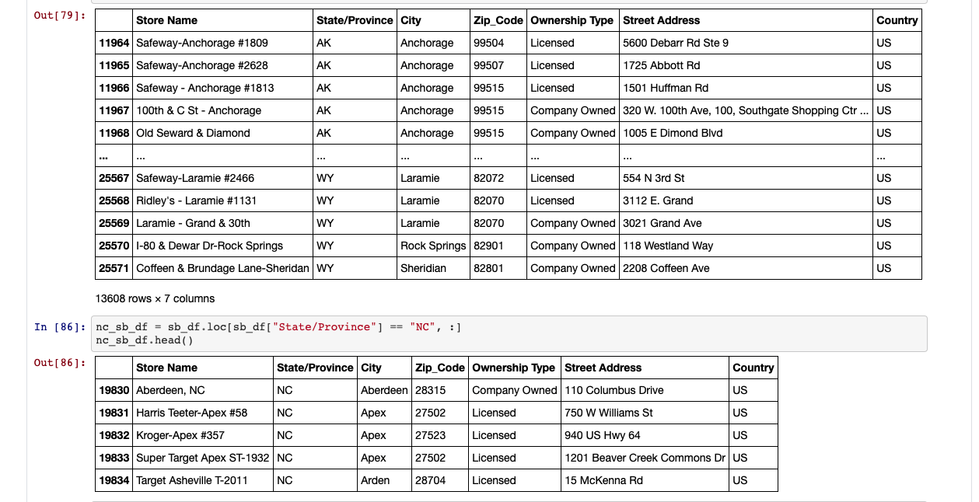
Filter the Dataset
Starbucks Locations DS
Filtered data to only display State of NC in lieu of various Countries/States

Slide 5

Analysis – Starbucks Data
Bar Chart:
The bar chart displays the 86 total cities in North Carolina that have 1 or more Starbucks locations.
Charlotte (located in Mecklenburg County) took the lead by far with 61 Starbucks locations
Most of the listed cities had just 1 Starbucks location
Pie Charts & Screenshot Images:
Top 6 NC Counties with Highest Zip Code Count
Top 6 NC Counties with Highest Count of Company Owned Locations
Top 6 NC Counties with Highest Count of Licensed Locations
* Mecklenburg County took the lead, followed by Wake County, in all 3 of these referenced categories
There are 1,046 total zip codes in the State of North Carolina; however, there are 894 zip codes without a Starbucks location
There are 750 total cities in the State of North Carolina; however, there are 664 cities without a Starbucks location
There are 100 total counties in the State of North Carolina; however, there are 55 counties without a Starbucks location

Slide 6
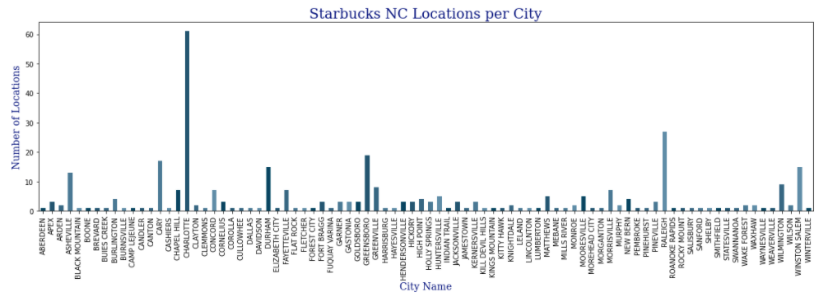
Notes:
Bar Chart:
The bar chart displays the 86 total cities in North Carolina that have 1 or more Starbucks locations.
Charlotte (located in Mecklenburg County) took the lead by far with 61 Starbucks locations
Most of the listed cities had just 1 Starbucks location

Slide 7
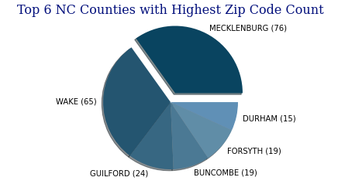
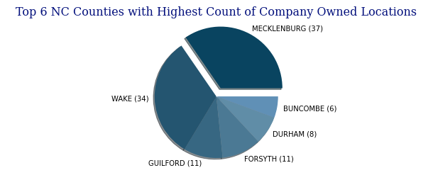
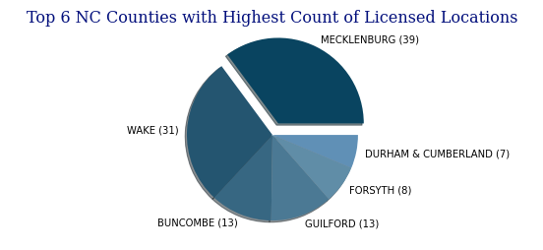
Zip Codes Vs. Locations

Slide 8
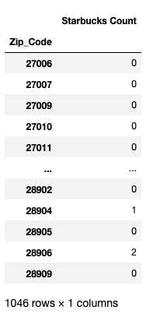
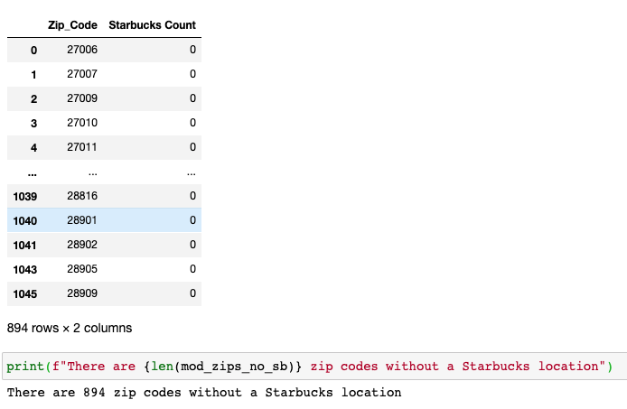
Zip Code Analysis by SB Location
Notes:
Only 15% of NC Zip Codes have at least one Starbucks location.

Slide 9
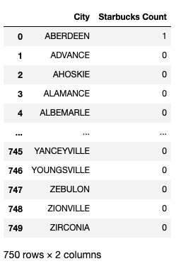
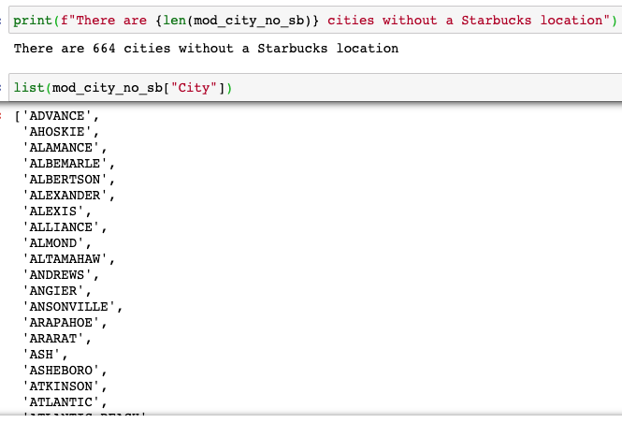
City Analysis by SB Location
Notes:
89% of NC Cities do not contain a Starbucks location.

Slide 10
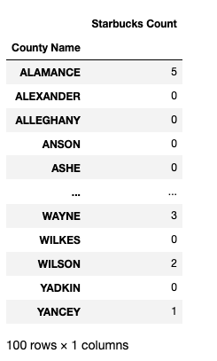
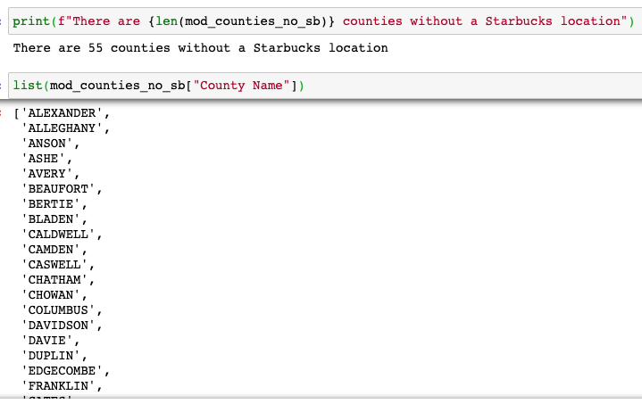
County Analysis by SB Location
Notes:
55% of NC Counties do not contain a Starbucks Location

Slide 11
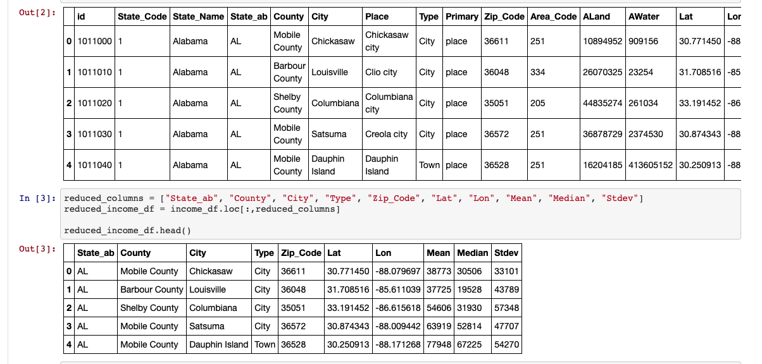
Cleaning & Merging the Datasets
U.S. Household Income DS
(Includes record data as of August 2017)
Focused on cleaning data for State, Postal Code, City, Mean Income, Median Income, # of Households

Slide 12
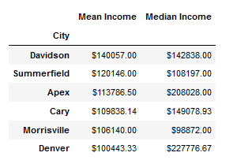
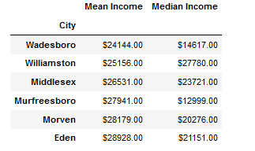
IMAGES
Lowest Average MEAN Income
Highest Average MEAN Income

Slide 13
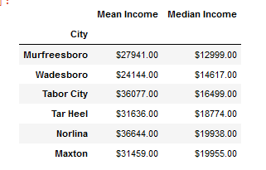
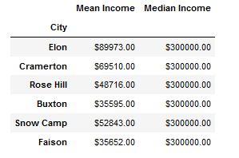
IMAGES
Lowest Average MEDIAN Income
Highest Average MEDIAN Income

Slide 14
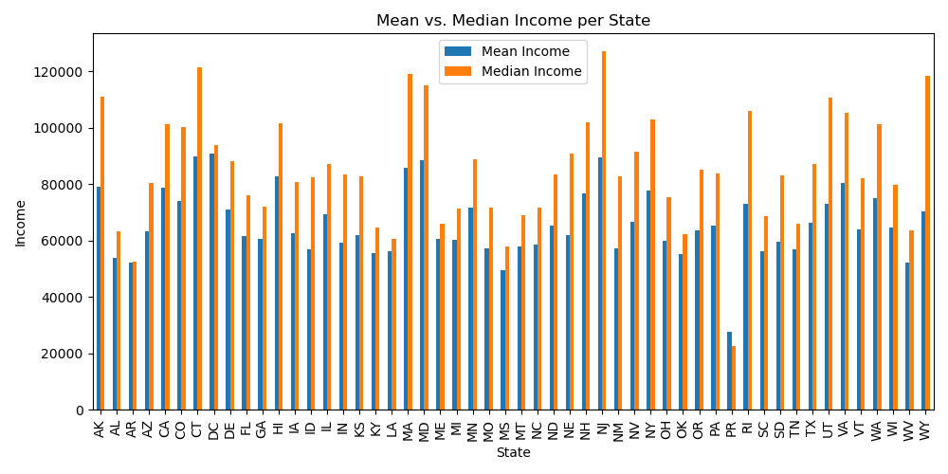
IMAGES

Slide 15
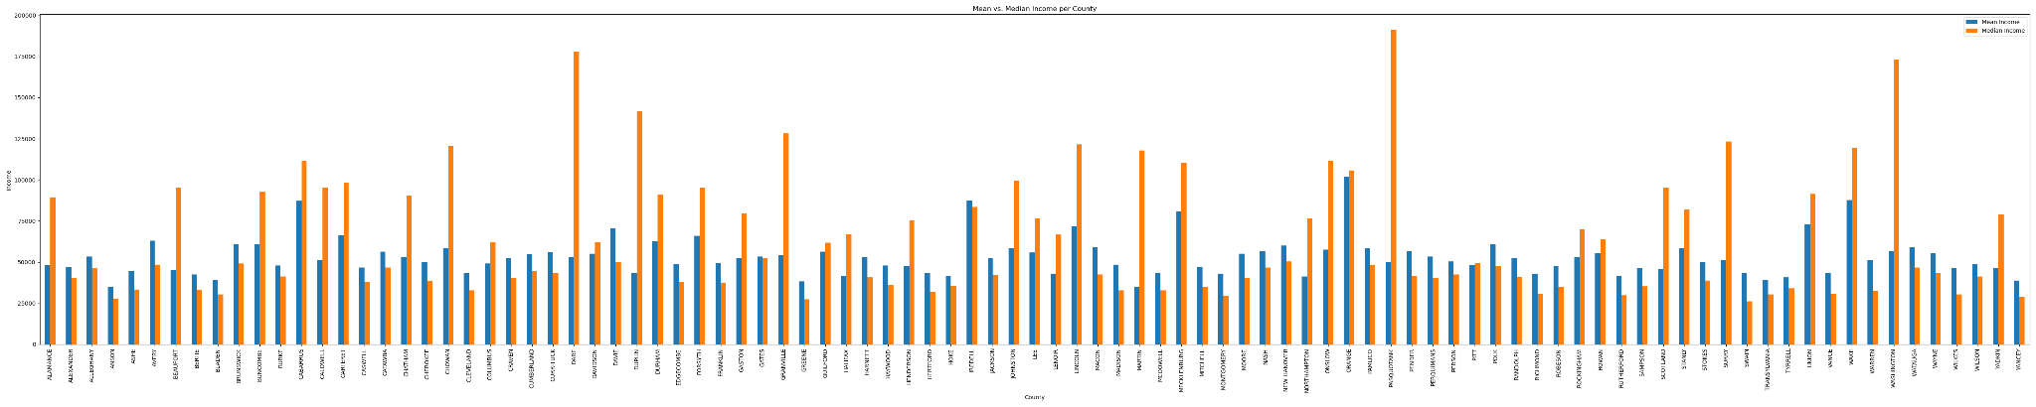
Median vs. Mean Income Comparison

Slide 16
Analysis – Income Data
Bar Charts:
The bar chart show the differences in the average mean and median incomes broken down by state, city, county, and zip code
State: NC is pretty average
City: most cities fall in the $50,000-$100,000 range
County: most counties fall closer to $50,000 than $100,000, with many falling below $50,000
Zip: higher variation than the other views
For all comparisons, most of the outliers have a significantly higher Median than Mean
Screenshot Images:
Cities with
highest Mean Income: Davidson, Summerfield, Apex, Cary, Morrisville, and Denver
lowest Mean Income: Wadesboro, Williamston, Middlesex, Murfreesboro, Morven, and Eden
highest Median income: Elon, Cramerton, Rose Hill, Buxton, Snow Camp, Faison
lowest Median income: Murfreesboro, Wadesboro, Tabor City, Tar Heel, Norlina, and Maxton
Counties with
highest Mean Income:Orange, Wake, Iredell, Cabarrus, Mecklenburg, and Union
lowest Mean Income: Martin, Anson, Greene, Yancey, Bladen, Transylvania
highest Median income: Pasquotank, Dare, Washington, Duplin, Granville, Surry
lowest Median income: Swain, Greene, Anson, Yancey, Montgomery, Rutherford

Slide 17
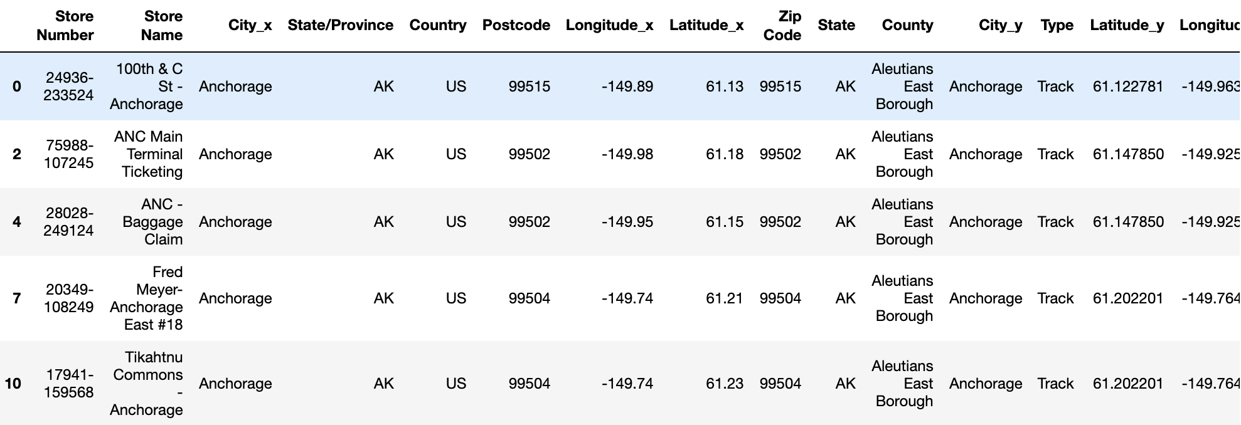
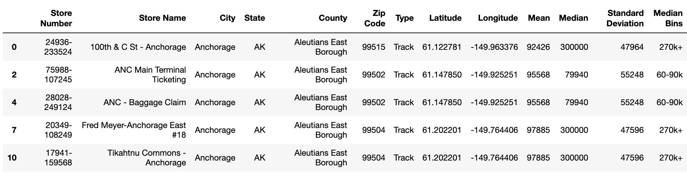
Starbucks vs. Income Analysis
Merging the Datasets
Filtered out the country data
Filtered out duplicate columns
Created bins based on the levels of median outcome

Slide 18
Summary Analysis – Combined Data
Bar Chart:
The bar chart showed a high amount of numbers in the $300k bin which seemed odd, further investigation revealed that the $300k bin included any median income value above $300k. So in reality, the bin would be smaller if it was a true $300k bin but the analysts who collected the data used a max cut off of $300k.
Cross referencing with the U.S. Census data (link in references), the median household income nationwide as of 2019 was $68,703. In our bar chart, the bins with the highest instances of Starbucks fall in the $30k to $90k bins. Looking at solely the bar chart, an assumption could be made that there wouldn’t be much of a positive correlation between median income.
State Scatter Plot:
The correlation between average median income and number of Starbucks is 0.3, giving us a very weak positive correlation.
After our findings with the bar chart about the $300k cutoff, we removed any data from the data set that fell into that category to increase the accuracy of the linear regression line.
The scatter plot shows one outlier based on its number of stores (California), but the median income per state all falls in between approximately $35k to $95k.
Since this scatter plot is taking the average median income per state, that value may not be the best representation to capture the entire state, so we also picked one state to look at a sample population.
NC City Scatter Plot:
The correlation between average median income and number of Starbucks is 0.1, giving us an even weaker positive correlation.
This scatter plot also implemented the removal of any data higher than $300k to increase the accuracy of the linear regression line.
This scatter plot boasted three outliers, Charlotte having a high of 12 Starbucks stores and Cornelius & Mooresville having a high median income of approximately $130k.
Looking at this sample, it gives us more cause to believe that there is little to no correlation between median income and Starbucks locations.
Since the correlations were so low and found to be not statistically significant, we found no reason to use the linear regression line equations to predict how many Starbucks would be within the vicinity of a certain median level of income as the outcome would not be accurate.

Slide 19
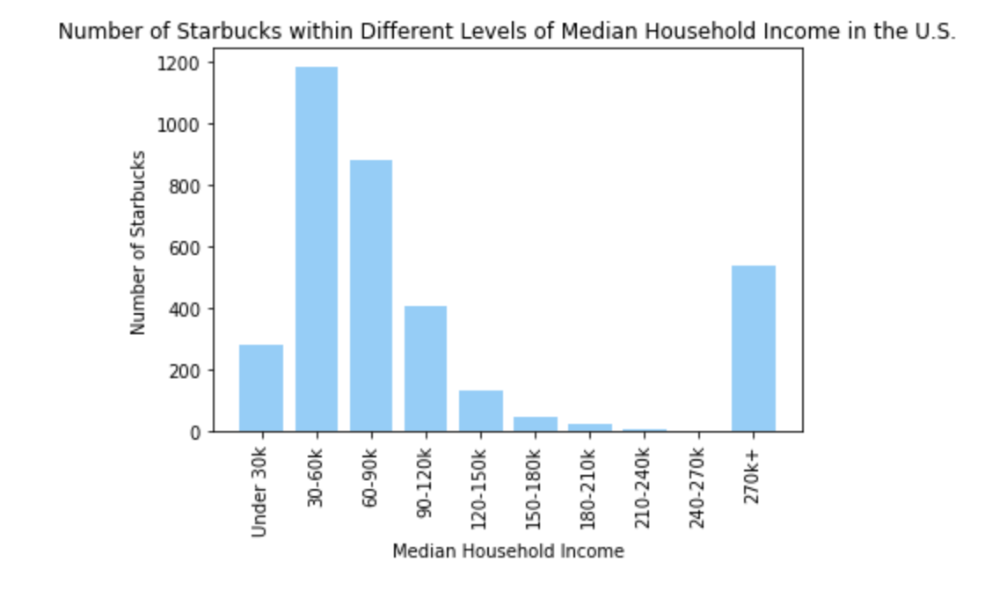
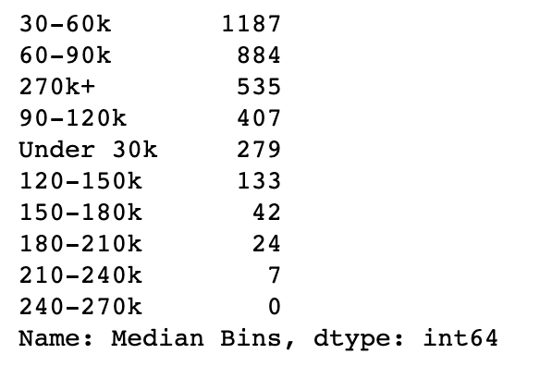
IMAGES

Slide 20
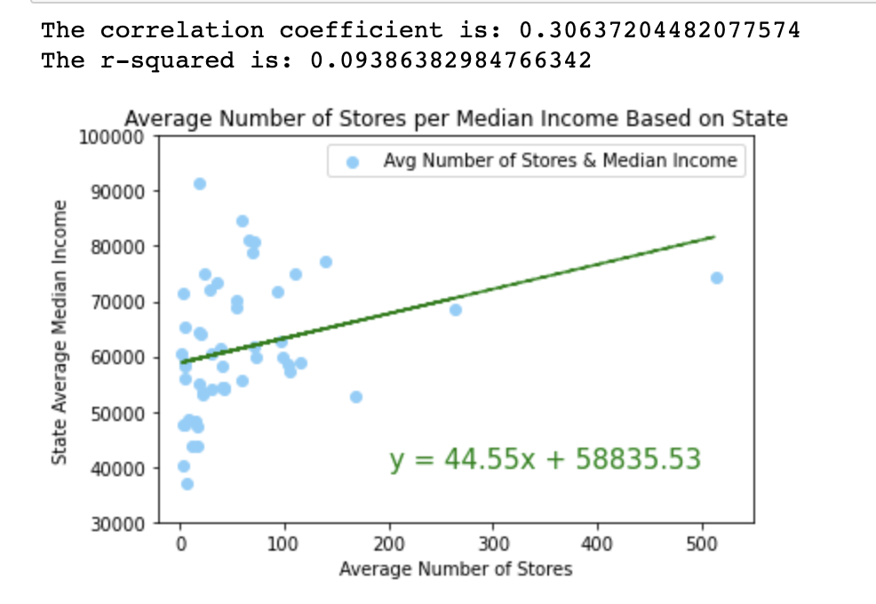
IMAGES

Slide 21
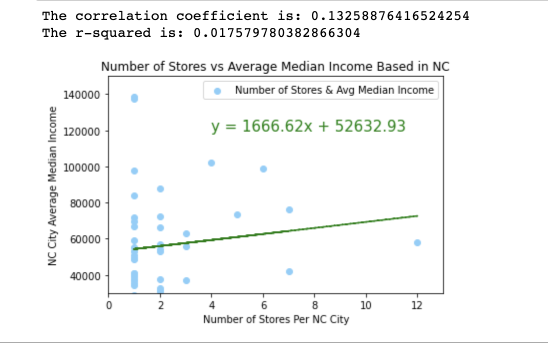
IMAGES

Slide 22
Limitations
Datasets came from 2017
The Starbucks dataset had no indication of success per location
Median household income dataset capped income at $300,000
Median household income did not reflect the size of the household
Analysis did not account for variance in other factors, such as population density.

Slide 23
References
Starbucks Locations Worldwide: https://www.kaggle.com/starbucks/store-locations
US Household Income Statistics: https://www.kaggle.com/goldenoakresearch/us-household-income-stats-geo-locations
Census data: https://www.census.gov/library/publications/2020/demo/p60-270.html#:~:text=Median%20household%20income%20was%20%2468%2C703,and%20Table%20A%2D1).

